Slide 1
MSc Project Recommender Systems: looking further into the future
Meeting: 27/06/2023

Slide 2
Evaluation:
Window-based evaluation:
Evaluate items based over the window instead of independently.
For window 7 → Use 700 negative samples.
Calculating NDCG@10, Hit Rate@10 and normalizing over the window size before averaging over the users.
Calculate Kendall’s same as before: Get window of test items, and the window of the predicted ranks → compare.
Results a worse than evaluating for each position into the future.

Slide 3
Experiments:
Baseline – SASRec next-item training:
Over all the k-steps into the future:
NDCG@10 Test Average: 0.3638
HR@10 Test Average: 0.7205
Kendall's Tau Average: 0.1604
For each k-step into the future:
NDCG@10 Test Average: 0.5556
HR@10 Test Average: 0.8164
Kendall's Tau Test Average: 0.1450
Sequence_Score@10 Test Average: 0.5278
HT_Ordered@10 Test Average: 0.6721
Next-item training – Independent Split Feeding:
Over all the k-steps into the future:
NDCG@10 Test Average: 0.3482
HR@10 Test Average: 0.6884
Kendall's Tau Average: 0.1156
For each k-step into the future:
NDCG@10 Test Average: 0.5226
HR@10 Test Average: 0.7929
Kendall's Tau Average: 0.1061
Sequence_Score@10 Test Average: 0.5087
HT_Ordered@10 Test Average: 0.6508

Slide 4
Experiments:
All Action Prediction:
Over all the k-steps into the future:
NDCG@10 Test Average: 0.2891
HR@10 Test Average: 0.5654
Kendall's Tau Average: 0.0914
For each k-step into the future:
NDCG@10 Test Average: 0.4101
HR@10 Test Average: 0.6576
Kendall's Tau Average: 0.0917
Sequence_Score@10 Test Average: 0.4160
HT_Ordered@10 Test Average: 0.5368
Dense All Action Prediction:
Over all the k-steps into the future:
NDCG@10 Test Average: 0.2110
HR@10 Test Average: 0.4328
Kendall's Tau Average: 0.0528
For each k-step into the future:
NDCG@10 Test Average: 0.2853
HR@10 Test Average: 0.5184
Kendall's Tau Test Average: 0.0492
Sequence_Score@10 Test Average: 0.3166
HT_Ordered@10 Test Average: 0.4175

Slide 5
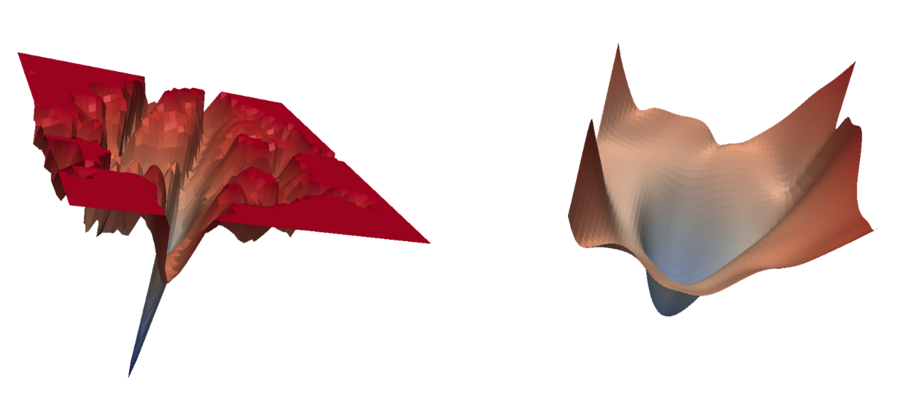
Sharpness Aware Minimazation:
SAM Optimizer for better learning:
Optimization technique that focuses on the sharpness of the loss landscape.
Traditional optimization methods (ADAM, SGD) find "sharp" minima, leading to poor generalization.
SAM aims to find "flat“/”wide” minima, leading to better generalization.
SAM first takes a step in the direction of the gradient, then adjusts the step to find a flat minimum.
Does a two-step update process where gradients are backpropagated twice, which helps in navigating towards flatter regions of the loss landscape.
Novel in recommender systems? Cannot find any previous study.
So far having an error → gradient computation has been modified by an inplace operation.

Slide 6
Future:
Fix SAM (for later).
Sampling ways in all action and dense all action.
Teacher-forcing approach?
[1,2,3,4,5] target is 5
Then [1,2,3,4,5(ground truth),6] target is 6
Autoregressive approach?
[1,2,3,4,5] target is 5
[1,2,3,4,5(predicted), 6] target is 6
Think about loss change to make multiple target predictions.

